Slide 1

Sea Animal Image Classification🌊
Kiran Ram Ganugula
kganu2@uis.edu
Prof:- Dr. Elham Buxton K
Deep Learning

Slide 2
Sea Animal Image Classification
Aquatic environments have been the birthplace of most life forms, with the oceans providing approximately 90% of the world's living space in terms of volume. The first known vertebrates were fish, exclusively found in water. Some fish evolved into amphibians, capable of surviving both on land and in water for parts of the day. Among amphibians, certain subgroups, including sea turtles, seals, manatees, and whales, further evolved into reptiles and mammals and We are in this project to detect the 23 different types of sea animals,using the Neural Network models.

Slide 3
Dataset
The dataset comprises various images of marine animals, sourced from different platforms. Images from pixabay.com are freely available for use without any licensing or attribution requirements. However, images sourced from flickr.com may require attribution to the original authors when used commercially. The dataset presently consists of 23 distinct classes of images, which may be expanded in the future.The images are resized to dimensions of either (300px, n) or (n, 300px), with n representing a pixel size less than 300px.

Slide 4
Variables
Clams
Corals
Crabs
Dolphin
Eel
Fish
Jelly Fish
Lobster
Nudibranchs
Octopus
Otter
Whale
Penguin
Puffers
Sea Rays
Sea Urchins
Seahorse
Seal
Sharks
Shrimp
Squid
Starfish
Turtle_Tortoise

Slide 5
Models Performed
Baseline Model
Baseline with Multilayer and Dropout layer
Depth wise separable and Residual Block
Transfer Learning Using the feature extension (DenseNet169)
Transfer Learning Using the “ResNet101”

Slide 6
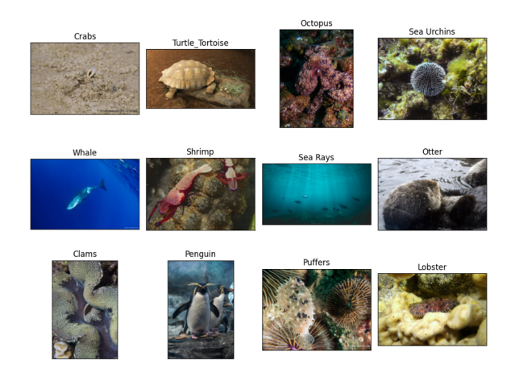
Visualising images from the dataset

Slide 7
Baseline Model
To begin constructing the CNN model, we start with an input layer that contains information regarding the shape and type of data that the model will be processing. Unlike the Dense layer, the image does not require flattening for the conv2D layer. We incorporated multiple blocks that feature progressively larger filters, each consisting of a convolutional layer, a ReLU activation function, a batch normalisation layer, and a max pooling layer. Following these blocks is a GlobalAveragePooling layer, culminating in an output layer that utilises the softmax activation function.

Slide 8
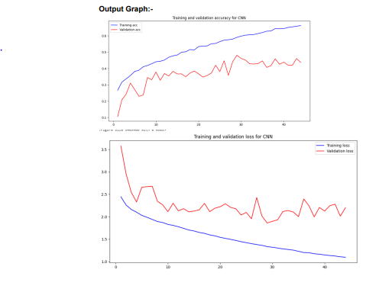
Output Graph:-

Slide 9
2. Baseline with Multilayer and Dropout layer
Adding more layers can help extract additional features from the data, but only to a certain extent. Beyond a certain point, adding more layers can lead to overfitting, where the model becomes too closely fitted to the training data and loses its ability to generalise to new data. Overfitting can result in issues such as false positives.Dropout layers are typically more effective when placed between fully connected/Dense layers. In this case, dropout can be applied after the GlobalAveragePooling layer.

Slide 10
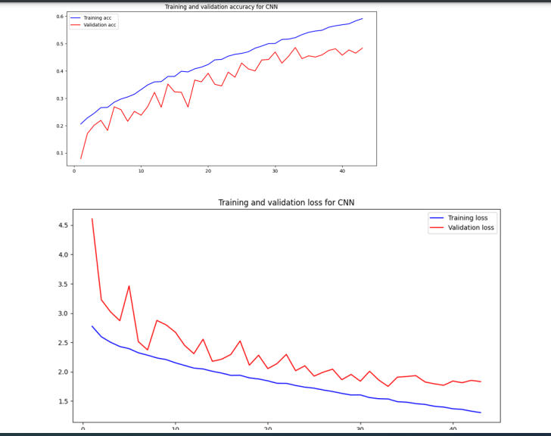
Output Graph:-

Slide 11
3. Depth wise separable and Residual Block
The ResNet architecture introduced the residual connection technique in 2015, which adds the input of a layer or block of layers back to its output, allowing the model to bypass the block if it increases training error. This residual link acts as a data shortcut around potentially harmful or noisy blocks, enabling error gradient information from early layers to pass through a deep network without noise.

Slide 12
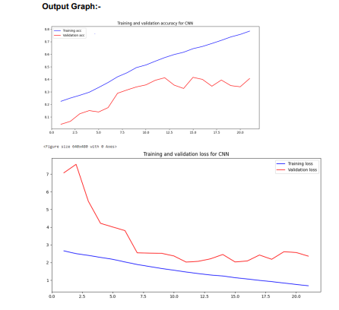
Output Graph:-

Slide 13
4. Transfer Learning Using the feature extension (DenseNet169)
One common technique for using a pretrained network is feature extraction. This involves taking the convolutional base (i.e., the convolutional layers and possibly batch normalization layers) of a well-known architecture (such as VGG, ResNet, Inception, DenseNet, etc.) that has been pretrained on ImageNet, running the new dataset through it to extract features, and then training a new classifier using these extracted features.

Slide 14
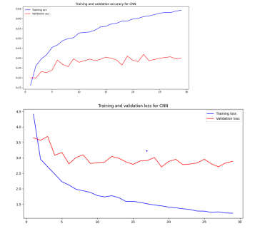
Output Graph:-

Slide 15
5. Transfer Learning Using the “ResNet101”
Using transfer learning with ResNet101 involves taking the pre-trained ResNet101 model and removing the top layers (typically the fully connected layers) that were trained on ImageNet, a large-scale dataset of images with over 1,000 classes. The remaining layers of ResNet101 are then used as a convolutional feature extractor for the new task.

Slide 16
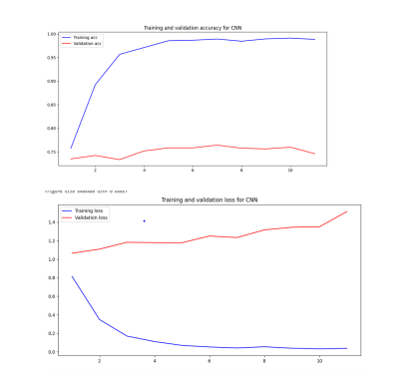
Output Graph:-

Slide 17
Fine Tuning
this fine-tuning technique allows the pre-trained model to adapt better to the new dataset by leveraging the features learned from the large-scale dataset used for pre-training.To achieve this, the code sets trainable to False for all layers except the last 9 layers of the conv_base network. Then, it sets trainable to True for only the convolutional layers in the last 9 layers.

Slide 18
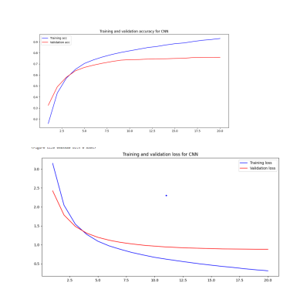
Output Graph:-

Slide 19
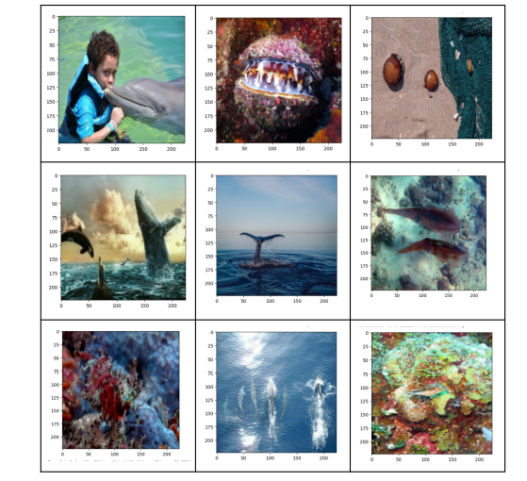
Showing misclassified images in the validation data

Slide 20
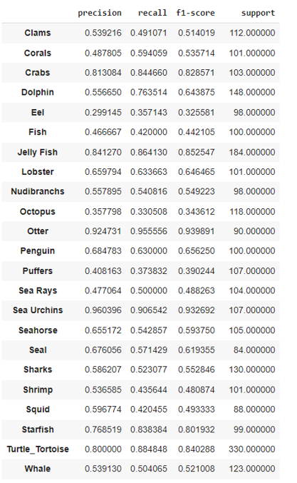
Classification Reports and Confusion Matrix

Slide 21
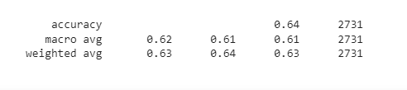

Slide 22
Classification Reports and Confusion Matrix
The output is a classification report which provides a summary of the performance of a machine learning model on each class of a multi-class classification problem.
For each class, the classification report shows the precision, recall, f1-score, and support. Precision is the ratio of true positives to the sum of true positives and false positives. Recall is the ratio of true positives to the sum of true positives and false negatives. The f1-score is the harmonic mean of precision and recall. The support is the number of samples in the true class.
The values in the output indicate the performance of the machine learning model on each class. For example, the precision of Clams is 0.54, which means that 54% of the samples predicted to be Clams are actually Clams. The recall of Clams is 0.49, which means that 49% of the actual Clams are correctly identified by the model. The f1-score of Clams is 0.51, which is the harmonic mean of precision and recall. The support of Clams is 112, which is the number of samples in the true class.
Overall, the classification report provides a good summary of the performance of the machine learning model and helps in evaluating the model's ability to classify samples into different classes.

Slide 23
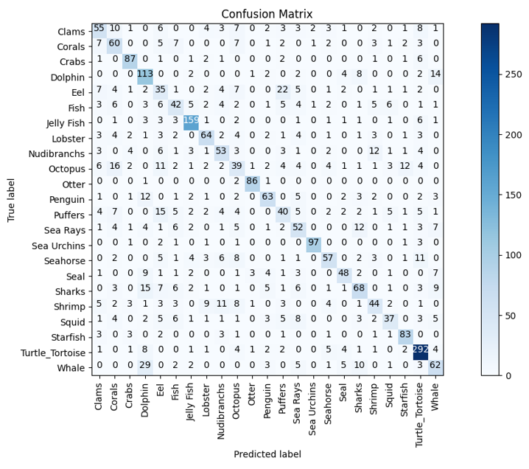
Confusion Matrix

Slide 24
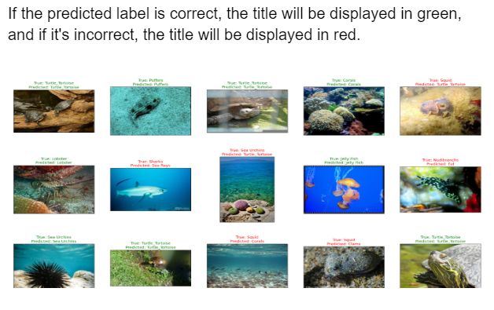
True Labels and Predicted Labels

Slide 25
Conclusion
Fine Tuning Help our model to improve a lot, its get the accuracy of 93% and validation loss 88%, this is the best output results we got.
The overall accuracy of the model on the test set is 0.636, which means that it correctly predicts the class label for 63.6% of the instances in the test set.
Looking at the individual class metrics, it appears that the model performs well on some classes, such as Sea Urchins, Otter, and Turtle_Tortoise, with high precision, recall, and F1-score. On the other hand, the model performs poorly on some classes, such as Eel, Octopus, and Sharks, with low precision, recall, and F1-score.

Slide 26
References
https://www.kaggle.com/code/mohameddeeb/sea-animals-cnn-with-scratch-pretrained-models
https://www.kaggle.com/code/vencerlanz09/sea-animals-classification-using-efficeintnetb7
https://www.kaggle.com/datasets/vencerlanz09/sea-animals-image-dataste

Slide 27
Thank You

